Slide 1
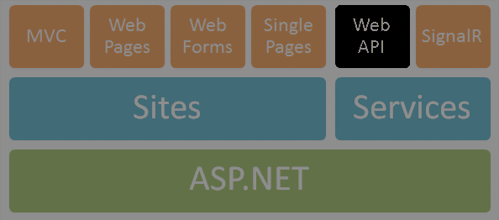
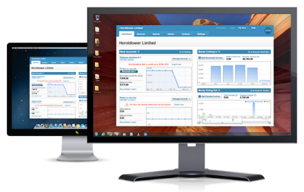




File Upload in ASP.NET
ASP.NET Web Forms
Telerik Software Academy
http://academy.telerik.com

Slide 2


Table of Contents
File Upload Concepts
Multipart HTTP Requests
File Upload in ASP.NET Web Forms
To server file
To memory stream
Using Kendo UI Upload
Using Telerik ASP.NET AJAX

Slide 3

File Upload Concepts
How files are sent through the web

Slide 4
File Upload Concepts
Done through forms
Content type should be “multipart/form-data”
Selected via input type “file” tag
Data is sent as POST method through http
Files are received and used at the server
<form id="FileUploadForm" runat="server">
<asp:FileUpload ID="FileControl" runat="server" />
<asp:Button runat="server" ID="UploadButton"
Text="Upload" OnClick="Upload" />
</form>

Slide 5
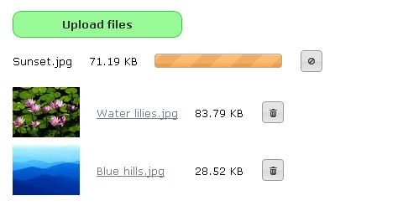
Multipart HTTP Request
Different kind of POST method

Slide 6
Multipart HTTP Request
Form is sent as multiple parts
Enable multipart – type “multipart/form=data”
Request is divided in parts
Content-Type: multipart/form-data; boundary=---------------------------7d81b516112482
Content-Length: 324
-----------------------------7d81b516112482
Content-Disposition: form-data; name="file";
filename=“Exam solution.doc"
Content-Type: text/plain
SomeText
-----------------------------7d81b516112482
Content-Disposition: form-data; name="submit"

Slide 7
Multipart HTTP Request
Live Demo

Slide 8
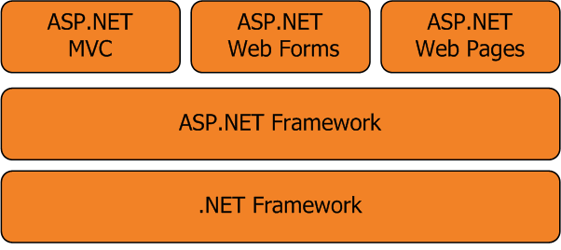
ASP.NET Web Forms File Upload
Done within minutes

Slide 9
ASP.NET File Upload Classes
Request.Files
Gets the collection of sent files (dictionary)
Uses MIME format
HttpPostedFile
Provides access to individual files
string FileName property
int ContentLength in bytes
InputStream – stream of the file
SaveAs(string fileName) – saves the file

Slide 10
ASP.NET File Upload Classes
FileUpload
bool HasFile – checks if file is uploaded
byte[] FileBytes – file content in binary
Stream FileContent – file as stream
string FileName – name of the file
HttpPostedFile PostedFile – posted file
IList<HttpPostedFile> PostedFiles – collection of all uploaded files

Slide 11
ASP.NET File Upload
Using <asp: FileUpload />
In the code behind
<asp:FileUpload ID="FileControl" runat="server" />
if (FileControl.HasFile)
{
string filename = Path.GetFileName
(FileControl.FileName);
FileControl.SaveAs(Server.MapPath
("~/Uploaded_Files/") + filename);
}

Slide 12
Simple File Upload
Live Demo

Slide 13
Restricted File Upload
You can check for certain file types
You can check for file size
if (FileControl.PostedFile.ContentType == "image/jpeg")
{
// Use file
}
else
{
// do not upload
}
if (FileControl.PostedFile.ContentLength < 102400)
{
// Use file
}
…

Slide 14
Restricted File Upload
Live Demo

Slide 15
Uploading To Stream
Saving file to stream
byte[] fileData = null;
Stream fileStream = null;
int length = 0;
if (FileUploadControl.HasFile)
{
length = FileControl.PostedFile.ContentLength;
fileData = new byte[length + 1];
fileStream = FileControl.PostedFile.InputStream;
fileStream.Read(fileData, 0, length);
}
MemoryStream stream = new MemoryStream(fileData);

Slide 16
Uploading To Stream
Live Demo

Slide 17

Kendo UI Upload Widget
Asynchronous and large files support

Slide 18

Kendo UI Upload
Kendo Upload widget
Easily done
Have upload and delete
Styled and ready to use
Supports asynchronous file upload
Supports multiple file upload at once
Supports sending large files in parts

Slide 19
Kendo UI Upload
Steps for asynchronous large multi-upload
Create landing page for the widget
Add input type “file” (no form required)
Add JavaScript for the widget
Add upload handler
Add remove handler (if you need it)
In web.config set request max length
<httpRuntime targetFramework="4.5"
executionTimeout="110" maxRequestLength="25000" />

Slide 20
Kendo UI Upload
Landing page
<input name="uploaded" id="uploaded" type="file" runat="server" />
<script>
$(document).ready(function () {
$("#uploaded").kendoUpload({
async: {
saveUrl: "Upload",
removeUrl: "Remove",
autoUpload: true,
}
});
});
</script>

Slide 21
Kendo UI Upload
Upload page
Get name of the input from Request.Files
Return empty response if successful
Response.Expires = -1;
HttpPostedFile file = Request.Files["uploaded"];
string savepath = Server.MapPath("~/Uploaded_Files/");
string filename = file.FileName;
file.SaveAs(savepath + filename);
Response.ContentType = "application/json";
Response.Write("{}");

Slide 22
Kendo UI Upload
Remove page
Get file from Request.Form[“fileNames”]
If file exists – delete it
var file = Request.Form["fileNames"];
if (file != null)
{
var fileName = Path.GetFileName(file);
var physicalPath = Path.Combine
(Server.MapPath("~/Uploaded_Files"), fileName);
if (File.Exists(physicalPath))
File.Delete(physicalPath);
}

Slide 23
Kendo UI Upload Widget
Live Demo

Slide 24

Telerik ASP.NET AJAX
Designed for Web Forms

Slide 25
Kendo UI Upload
Steps for asynchronous file upload
Install ASP.NET AJAX Controls
Add RadAsyncUpload control to a page
Add RadScriptManager (in web.config too)
Set MultipleFileSelection
Set TargetFolder
Add RadButton or normal ASP submit button

Slide 26
Telerik ASP.NET AJAX
Live Demo

Slide 27
ASP.NET File Upload
http://academy.telerik.com

Slide 28
Homework
Create a Web Forms upload page using Kendo UI / ASP.NET AJAX Controls for archive with text files. The upload must work only with .zip file extension. You should not write the zip file into the server file system. Save the file to the memory and using external library, extract the text files and save their content into the database. The text files should not be saved to the file system either.

Slide 29




Free Trainings @ Telerik Academy
C# Programming @ Telerik Academy
csharpfundamentals.telerik.com
Telerik Software Academy
academy.telerik.com
Telerik Academy @ Facebook
facebook.com/TelerikAcademy
Telerik Software Academy Forums
forums.academy.telerik.com

